Slide 1

Corona Virus Analysis
SQL Task

Slide 2
Problem statement
This project is designed to test your SQL and data analysis skills in a real-world context.
You are encouraged to be creative in your approach and to seek guidance and assistance as needed throughout the internship.
Overview:
The CORONA VIRUS pandemic has had a significant impact on public health and has created an urgent
need for data-driven insights to understand the spread of the virus. As a data analyst, you have been
tasked with analyzing a CORONA VIRUS dataset to derive meaningful insights and present your findings.

Slide 3
Dataset overview
Description of each column in dataset:
Province: Geographic subdivision within a country/region.
Country/Region: Geographic entity where data is recorded.
Latitude: North-south position on Earth's surface.
Longitude: East-west position on Earth's surface.
Date: Recorded date of CORONA VIRUS data.
Confirmed: Number of diagnosed CORONA VIRUS cases.
Deaths: Number of CORONA VIRUS related deaths.
Recovered: Number of recovered CORONA VIRUS cases.

Slide 4
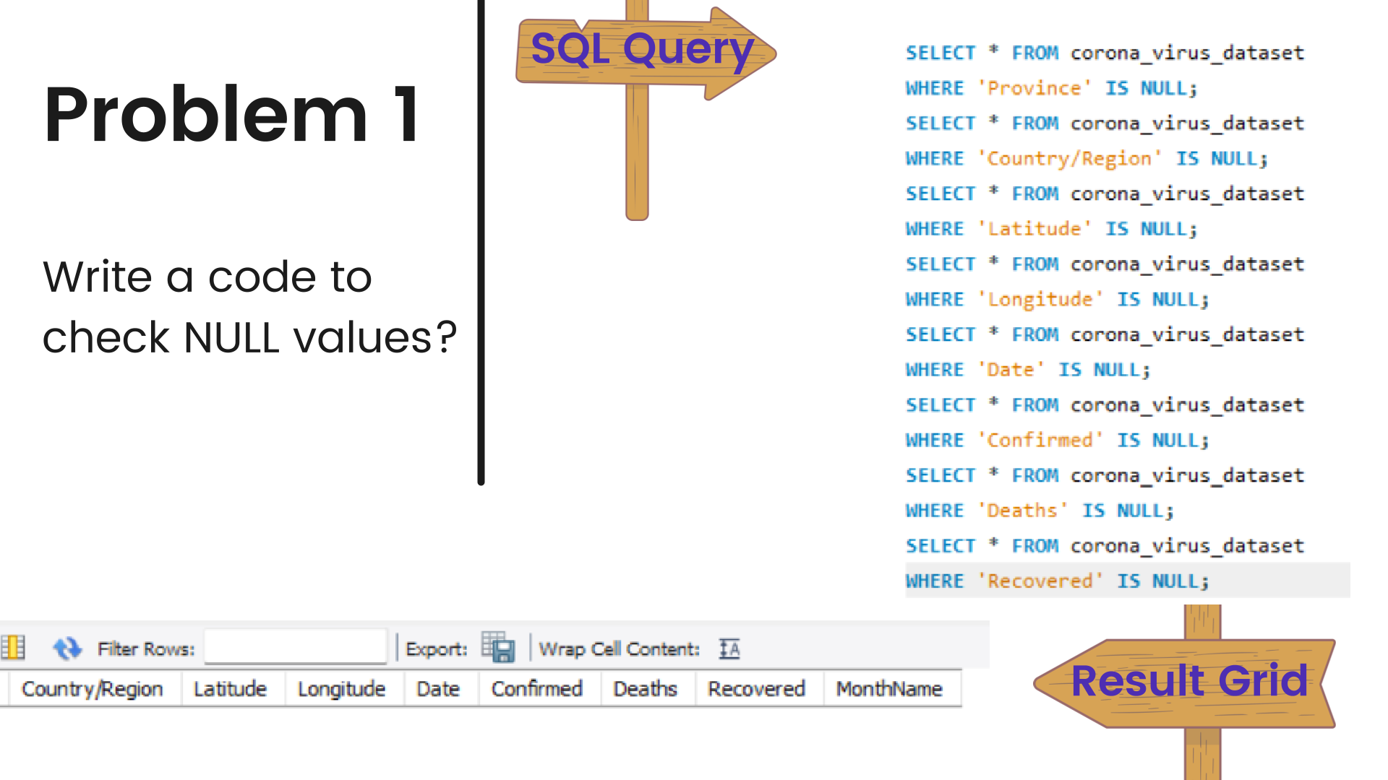

Slide 5


Slide 6
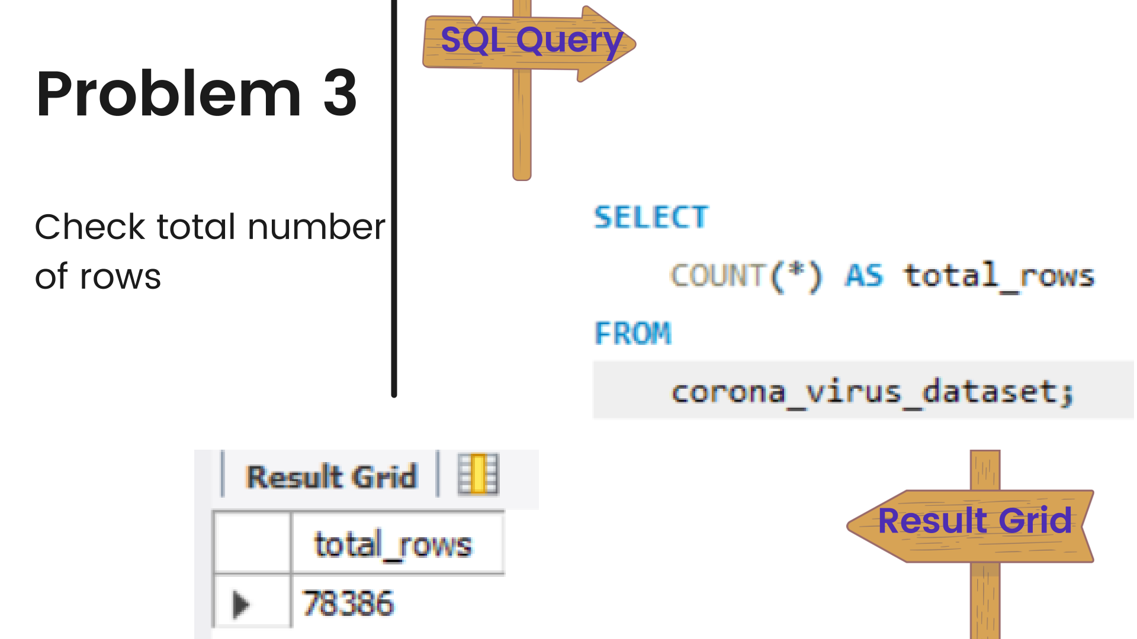

Slide 7
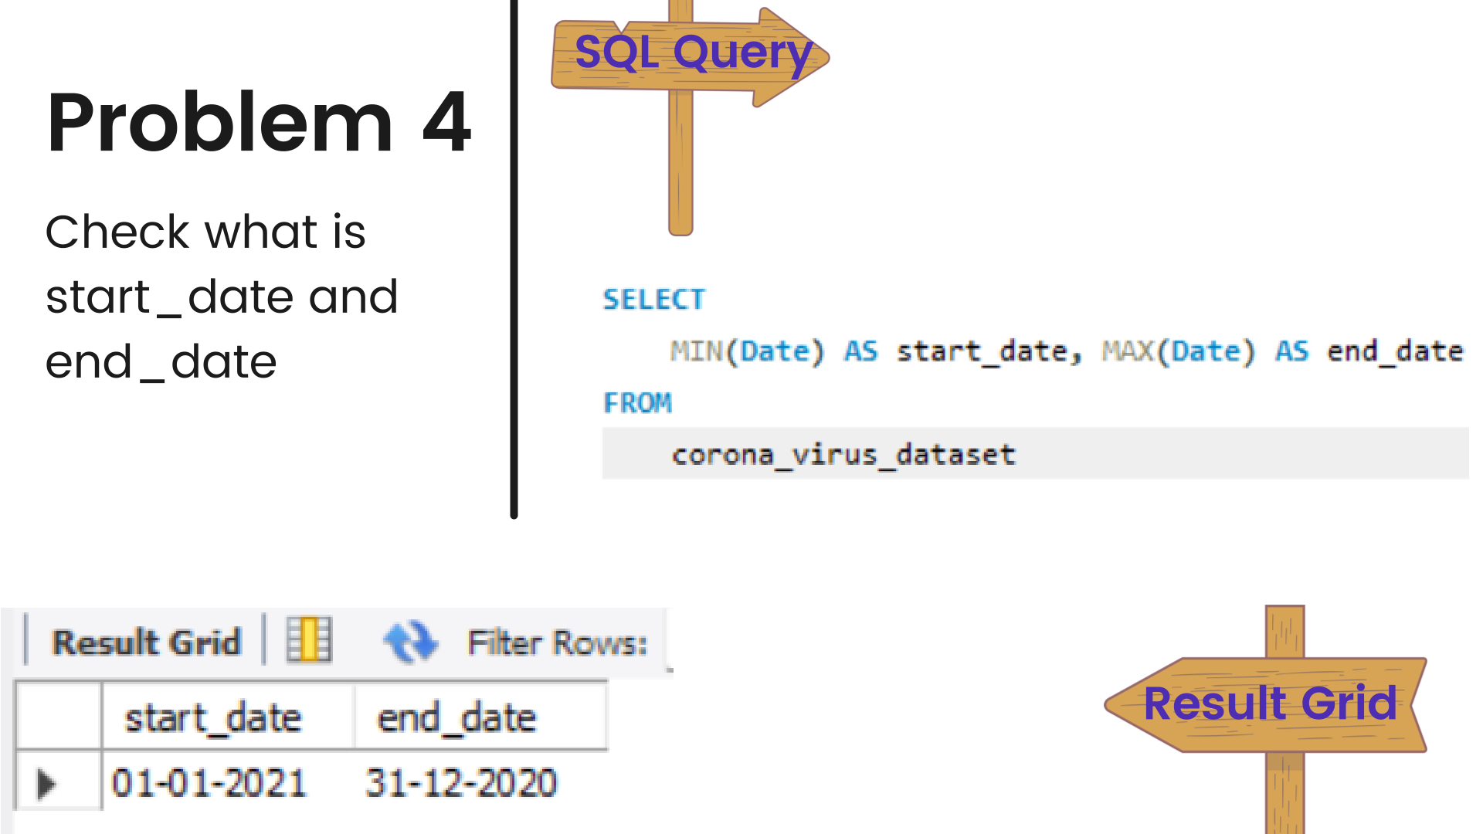

Slide 8
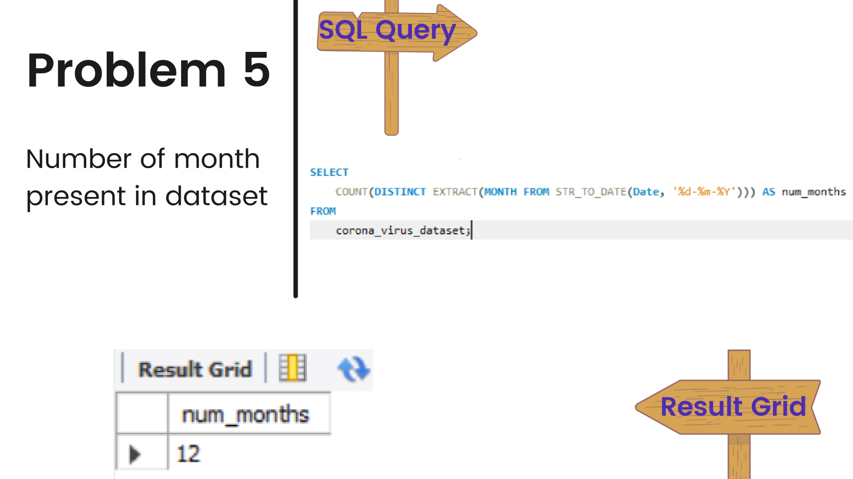

Slide 9
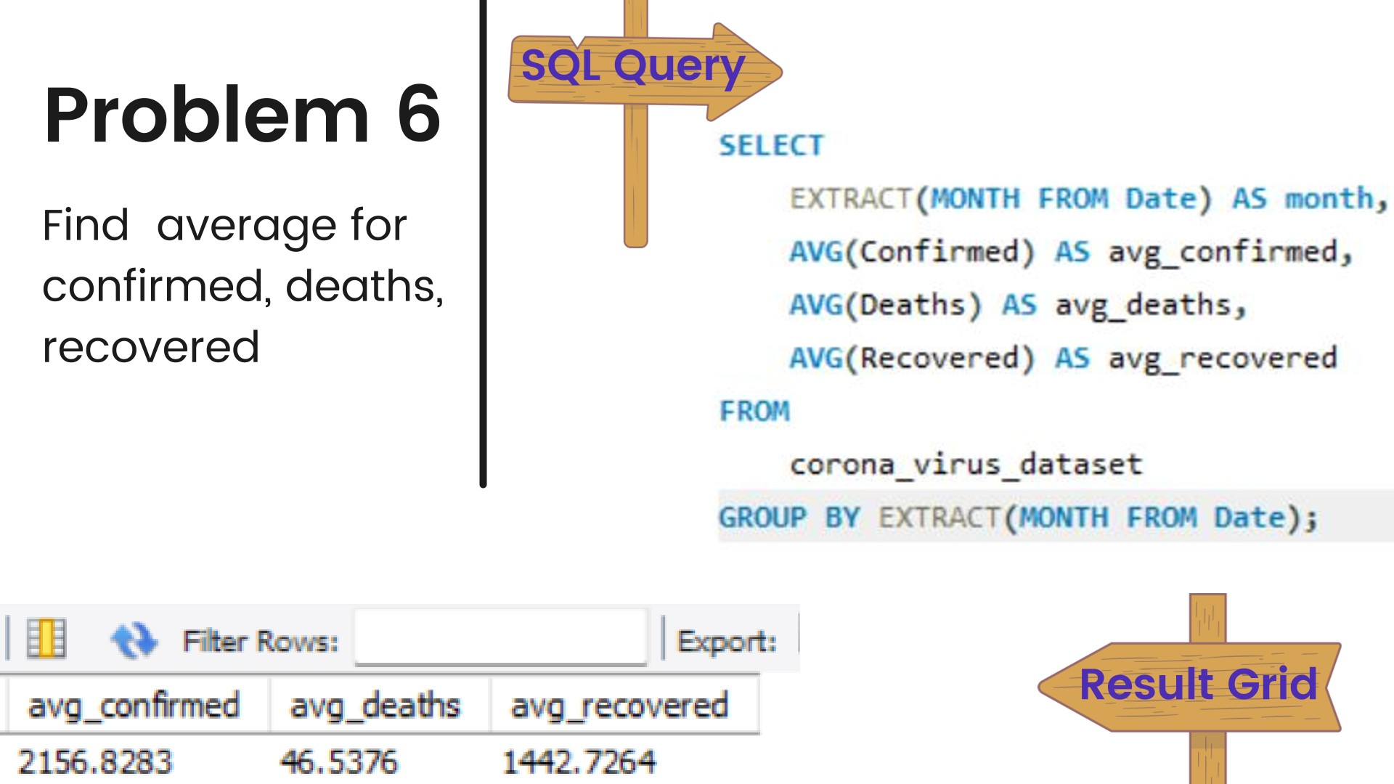

Slide 10
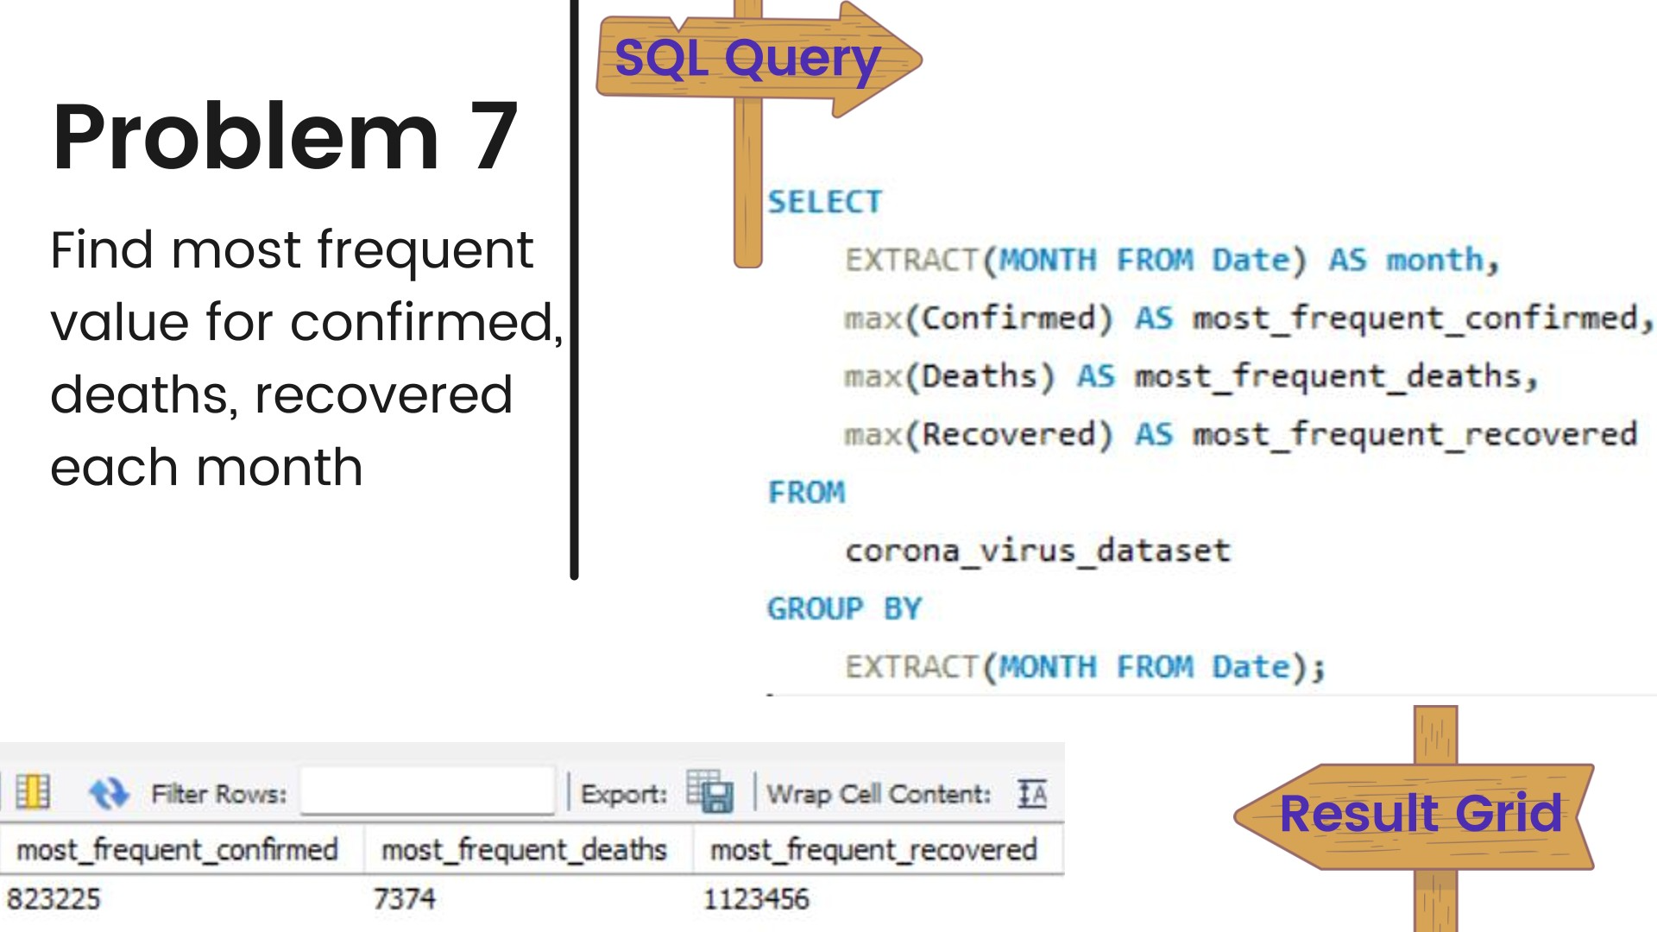

Slide 11
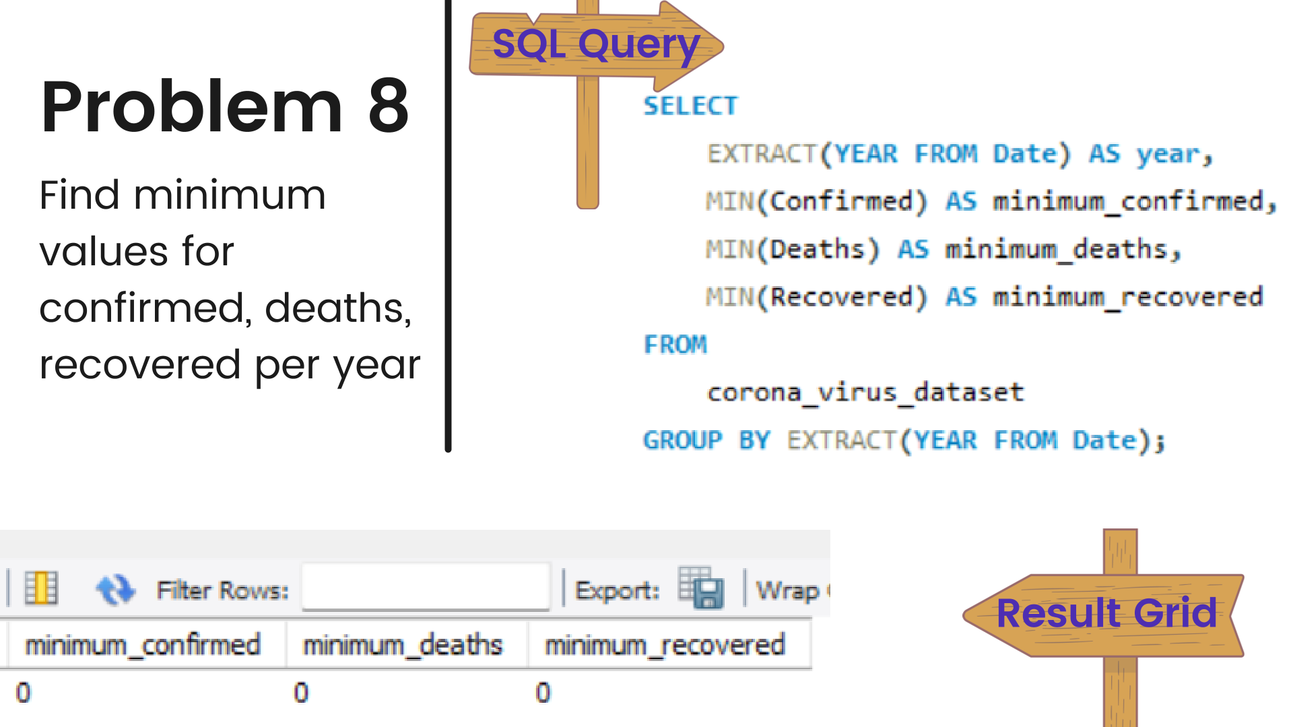

Slide 12
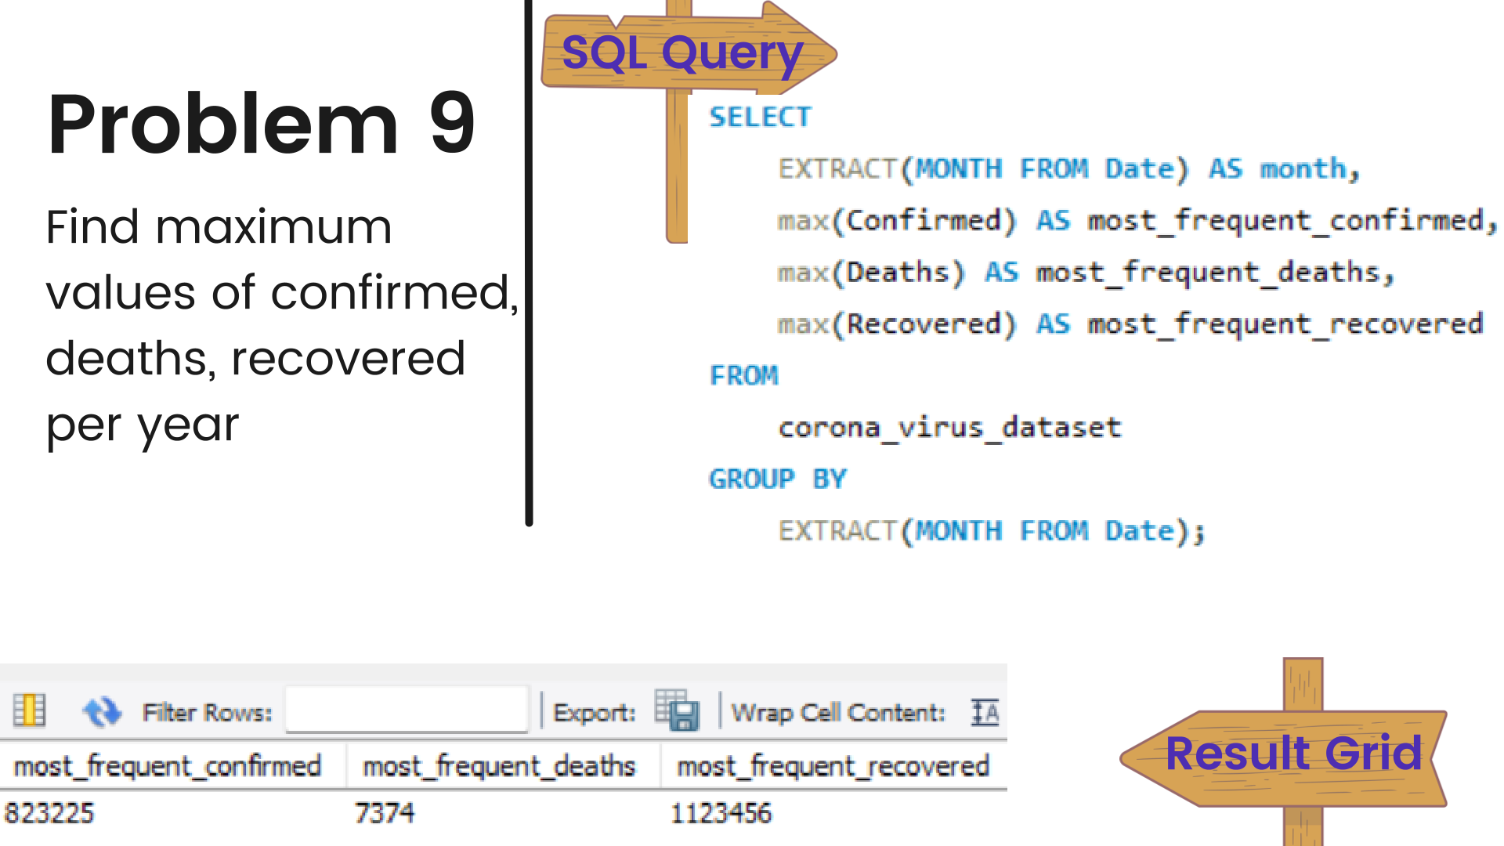

Slide 13
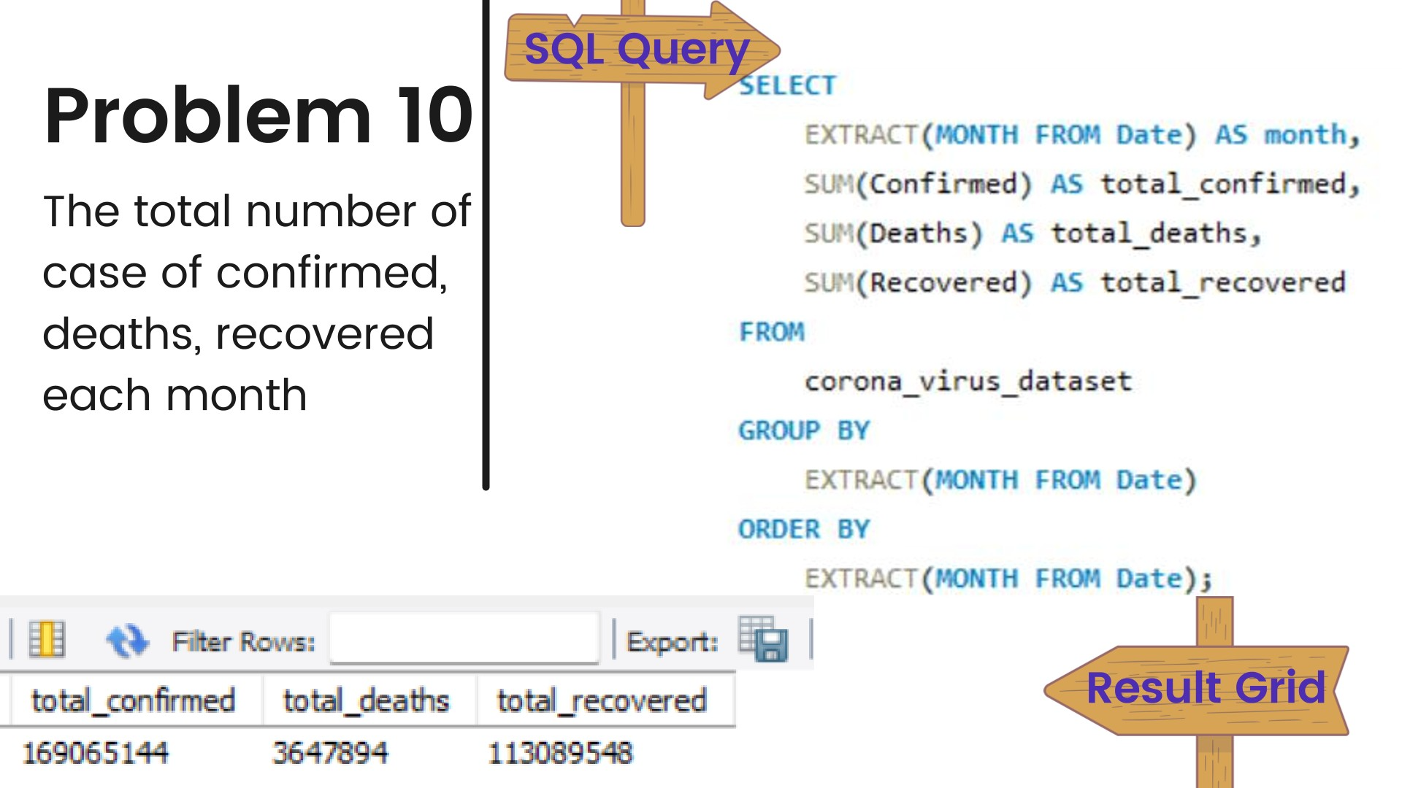

Slide 14
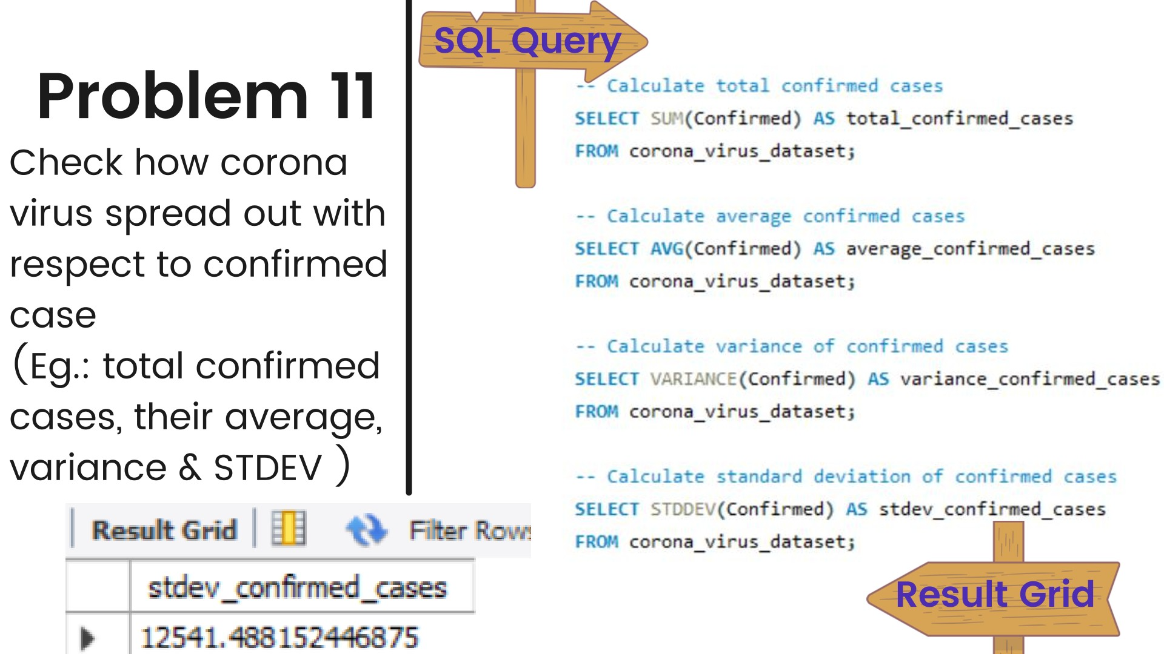

Slide 15
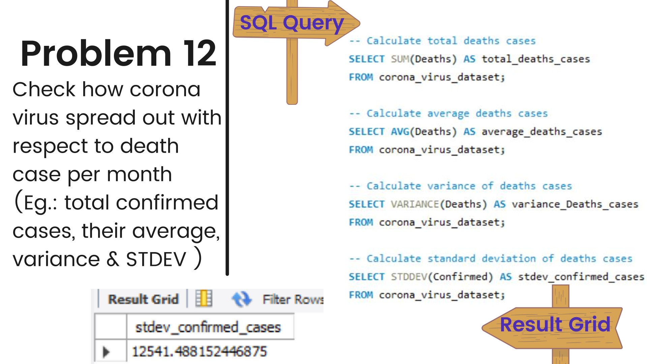

Slide 16
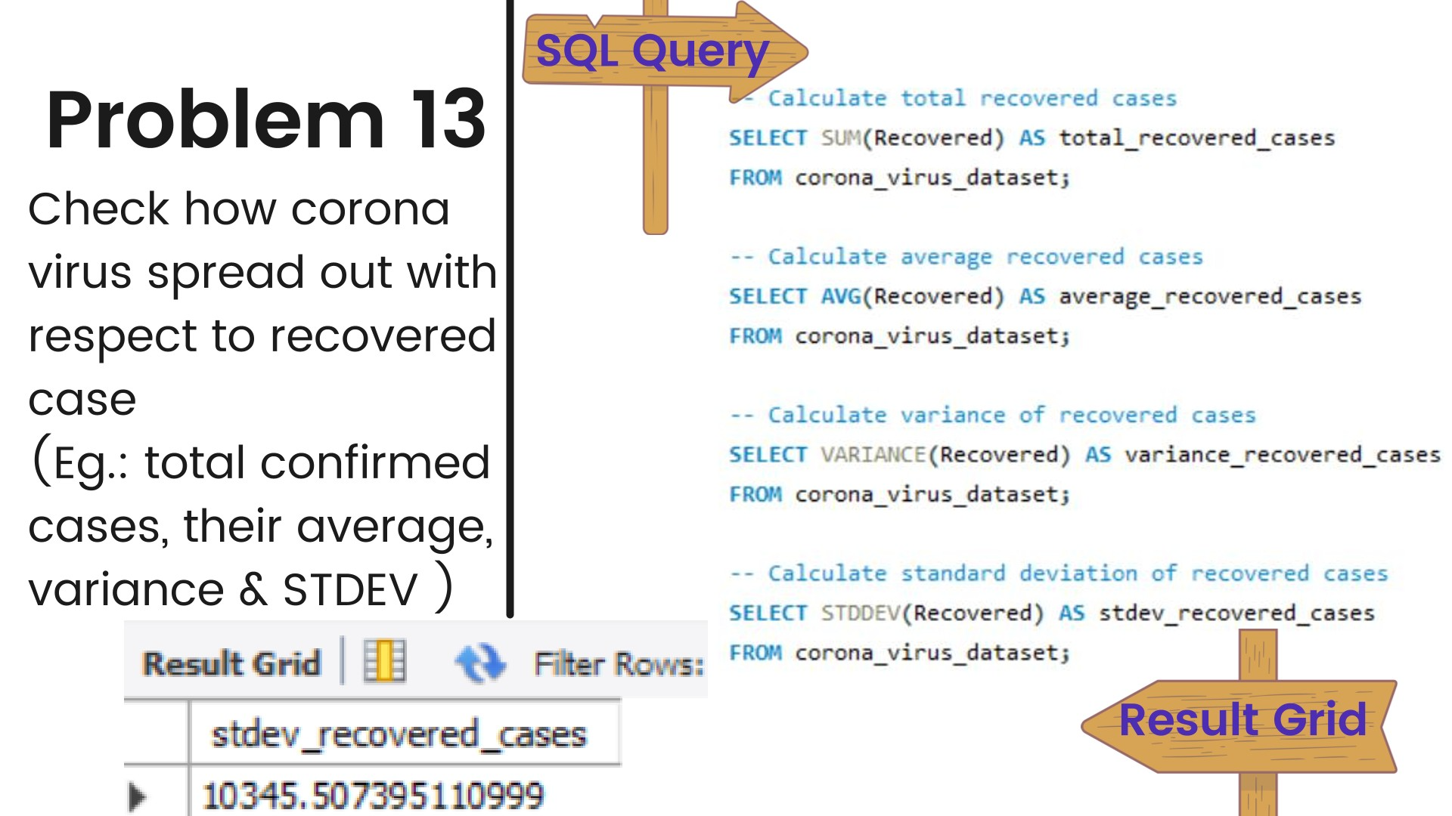

Slide 17
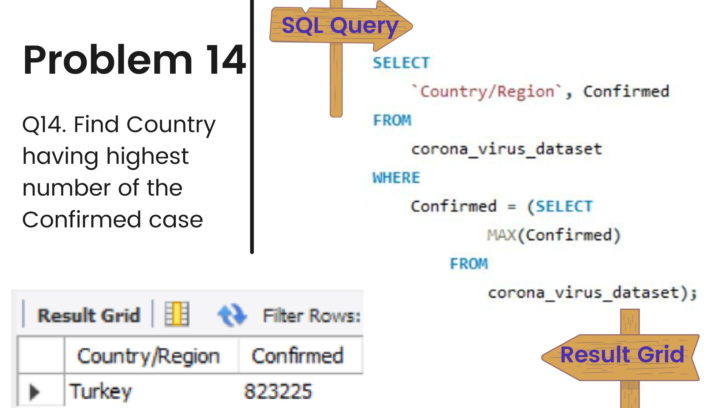

Slide 18
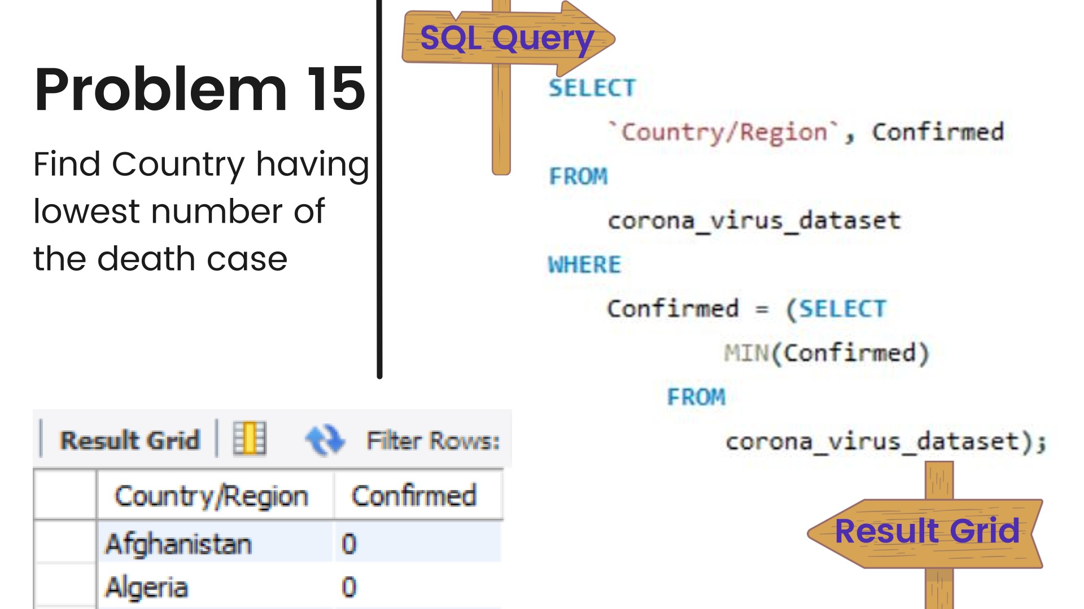

Slide 19
